Slide 1
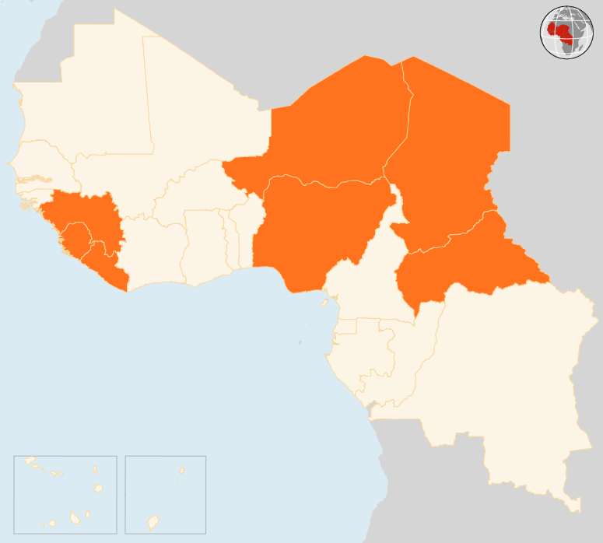

29 Sep – 5 Oct 2015
CENTRAL AFRICAN REPUBLIC (CAR)
CALM SLOWLY RETURNING IN BANGUI
Calm is gradually returning in Bangui following the eruption of violence on 26 September in which at least 42 people were killed, over 300 injured and 37,000 displaced. Businesses, public transport and other activities are slowly resuming in the city centre. However, there are still barricades on certain roads and criminal activities have been reported in various neighbourhoods. Population movement and humanitarian access are still difficult due to insecurity.
CHAD
GUNMEN RAID VILLAGE
On September 29 suspected Boko Haram gunmen attacked Bikaram village in the southern Lac region, torched houses and stole food stocks. No casualties were reported. However, at least 10,000 people have been displaced following the raid and another one that occurred a week earlier. The displaced are living in makeshift camps near Daboua and Ngouboua areas. Local authorities have set up a team to identify the newly displaced people and their needs, but insecurity is hindering access.
GUINEA
50 WOUNDED IN PRE-ELECTION VIOLENCE
Around 50 people were wounded following clashes that erupted in Guinea’s south-eastern N’Zérékoré area on 2 October. The political unrest occurred just days ahead of presidential election scheduled for 11 October. It was the second eruption of violence in the run-up to the poll. Opposition parties have called for the vote to be postponed until later in October on grounds that there are anomalies that need to be corrected in the voters roll.
NIGER
SIX KILLED IN SUICIDE ATTACK
A double suicide bombing on 4 October killed five civilians and a policeman in the south-eastern Diffa town. Renewed attacks by suspected Boko Haram militants have shattered weeks of calm in Diffa area, which had suffered several insurgent attacks since the start of the year.
NIGERIA
OVER 30 KILLED IN BOMB ATTACKS
At least 17 people died and 54 others were injured in coordinated bomb attacks on the night of 2 October in Kuje and Nyanya areas on the outskirts of the capital Abuja. Separately, five children (4 girls and 1 boy) are suspected to have been used as suicide bombers in a series of blasts in the north-eastern city of Maiduguri on 1 October which killed 15 people, including the bombers and injured more than 35 in the attacks at a mosque and the house of a vigilante group leader.
EVD REGIONAL
0 NEW CASES REPORTED
No new cases were reported in Guinea, Liberia and Sierra Leone in the week ending on 4 October. As of 2 October, Liberia had gone for 80 days without any confirmed case. Sierra Leone started a new 42-day count-down on 26 September when the last patients were discharged from a treatment centre. Guinea has launched campaigns to strengthen epidemiological surveillance in Ratotma and Dixinn areas targeting around 16,000 people.
NIGER
6
KILLED IN SUICIDE BLASTS
CHAD
GUNMEN RAID VILLAGE
NIGERIA
32
KILLED IN BOMB ATTACKS
CAR
CALM RETURNS AFTER VIOLENCE
EVD REGIONAL
GUINEA
0
NEW CASE REPORTED
50
WOUNDED IN PRE-POLL VIOLENCE
Creation date: 6 October 2015 Map data sources: UNCS, DevInfo, OCHA. Feedback: ocharowca@un.org
The boundaries and names shown and the designations used on this map do not imply official endorsement or acceptance by the United Nations.

